Slide 1

ASP.NET Core
hidden gems
API edition
@FanieReynders

Slide 2

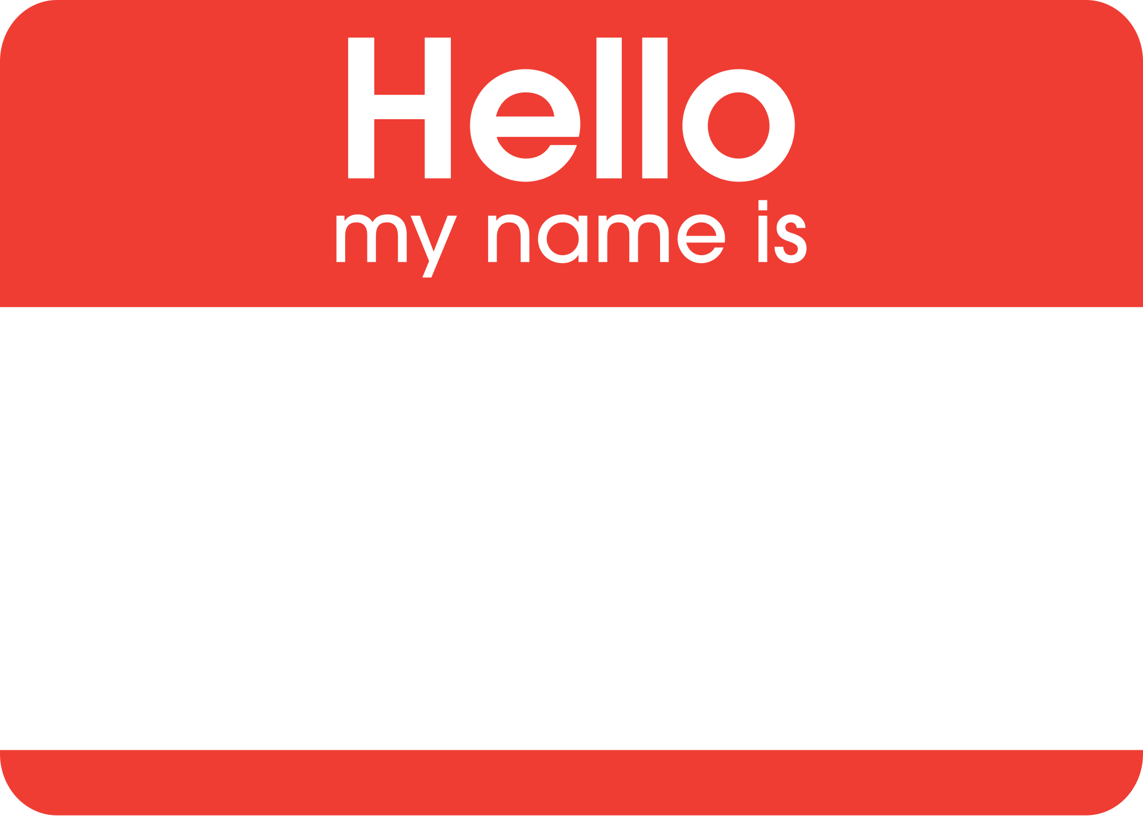








Fanie Reynders
Freelance Cloud Architect
https://reynders.co
/FanieReynders

Slide 3

Application Startup

Slide 4
Hosting Models
var host1 = WebHost.CreateDefaultBuilder(); //legacy ASP.NET Core
var host2 = WebApplication.CreateBuilder(); //modern ASP.NET Core
var host3 = Host.CreateDefaultBuilder(); //generic host

Slide 5
Startup.cs
public class Startup
{
// Optional
public void ConfigureServices(IServiceCollection services) { }
// Required
public void Configure(IApplicationBuilder app) { }
}

Slide 6
Inline configuration
Host
.CreateDefaultBuilder()
.ConfigureWebHost(webHost =>
webHost
.UseStartup<Startup>()
.UseKestrel())
.Build()
.Run();

Slide 7
Inline configuration
Host
.CreateDefaultBuilder()
.ConfigureWebHost(webHost =>
webHost
.ConfigureServices(services => services.AddMvc())
.Configure(app => app.UseMvc())
.UseKestrel())
.Build()
.Run();

Slide 8
Configuration as class
public class Startup
{
// Optional
public void ConfigureServices(IServiceCollection services) { }
// Required
public void Configure(IApplicationBuilder app) { }
}

Slide 9
Configuration as class (per environment)
public class Startup[Environment]
{
// Optional
public void Configure[Environment]Services(IServiceCollection services) { }
// Required
public void Configure[Environment](IApplicationBuilder app) { }
}

Slide 10
ASPNETCORE_ENVIRONMENT=Foo

Slide 11
Host
.CreateDefaultBuilder()
.ConfigureWebHost(webHost =>
webHost
.UseStartup(Assembly.GetExecutingAssembly().FullName);
.UseKestrel())
.Build()
.Run();
public class StartupFoo
{
public void ConfigureServices(IServiceCollection services) { }
public void Configure(IApplicationBuilder app) { }
}
public class StartupBar
{
public void ConfigureServices(IServiceCollection services) { }
public void Configure(IApplicationBuilder app) { }
}

Slide 12
public class Startup
{
// Optional
public void ConfigureFooServices(IServiceCollection services) { }
// Required
public void ConfigureFoo(IApplicationBuilder app) { }
// Optional
public void ConfigureBarServices(IServiceCollection services)
{
services.AddSingleton<IAwesome, Awesome>();
}
// Required
public void ConfigureBar(IApplicationBuilder app, IAwesome awesome) { }
}

Slide 13



Slide 14
Startup filters
public interface IStartupFilter
{
Action<IApplicationBuilder> Configure(Action<IApplicationBuilder> next);
}

Slide 15
public class AwesomeStartupFilter : IStartupFilter
{
public Action<IApplicationBuilder> Configure(Action<IApplicationBuilder> next) =>
builder =>
{
builder.Use(async (context, _next) =>
{
if (context.Request.Query["key"] != "1234")
await context.Response.WriteAsync("You had one job!");
else
await _next();
});
next(builder);
};
}

Slide 16
Startup filters
var builder = WebApplication.CreateBuilder();
builder.Services.AddTransient<IStartupFilter, AwesomeStartupFilter>();
var app = builder.Build();
app.MapGet("/", () => "Hello World!");
app.Run();

Slide 17
Startup filters
Startup filter 1
Startup filter 2
Startup filter 3
Application

Slide 18
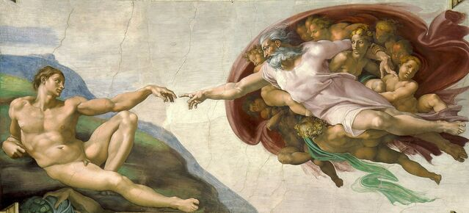

Servers & Clients

Slide 19
Server definition
public interface IServer : IDisposable
{
IFeatureCollection Features { get; }
Task StartAsync<TContext>(IHttpApplication<TContext> application,
CancellationToken cancellationToken);
Task StopAsync(CancellationToken cancellationToken);
}

Slide 20
Request map
Application host
Client
HTTP
Server
(Kestrel)
HttpContext
Application

Slide 21
Torenvalk server
In folder
Application host
File
Text
Request
Server
(Torenvalk)
Application
Response
Out folder
Stream
File

Slide 22
{method}->{request:path}
KRIJGEN->api:weer:vandaag
VERWIJDEREN->api:personen:1
VERZENDEN->api:bericht

Slide 23
Demo: Custom Server

Slide 24
HttpClient
IDisposable - object is gone but connection is not
Socket exhaustion
Use singleton, but connections remain open – DNS TTL
Hard* to test

Slide 25
HttpClientFactory
Factory for creating HTTP clients > ASP.NET Core 2.1
Easy to test
Consumption patterns
Direct
Named
Typed
Generated

Slide 26
HttpClientFactory - Direct usage
builder.Services.AddHttpClient();
// ...

Slide 27
// Usage - direct
public class MyController : Controller
{
public async IActionResult Get(IHttpClientFactory httpClientFactory)
{
var client = httpClientFactory.CreateClient();
client.DefaultRequestHeaders.Add("Accept", "application/json");
client.DefaultRequestHeaders.Add("User-Agent", "Awesome");
var result = await client.GetStringAsync("https://api.awesome.io/foo");
return Ok(result);
}
}

Slide 28
HttpClientFactory – Named client
builder.Services.AddHttpClient("awesome", c =>
{
c.BaseAddress = new Uri("https://api.awesome.io");
c.DefaultRequestHeaders.Add("Accept", "application/json");
c.DefaultRequestHeaders.Add("User-Agent", "Awesome");
});
// ...

Slide 29
// Usage – named client
public class MyController : Controller
{
public async IActionResult Get(IHttpClientFactory httpClientFactory)
{
var client = httpClientFactory.CreateClient("awesome");
var result = await client.GetStringAsync("foo");
return Ok(result);
}
}

Slide 30
HttpClientFactory – Typed client
builder.Services.AddHttpClient<AwesomeService>();
// ...

Slide 31
public class AwesomeService
{
public HttpClient _client { get; private set; }
public AwesomeService(HttpClient client)
{
client.BaseAddress = new Uri("https://api.awesome.io");
client.DefaultRequestHeaders.Add("Accept", "application/json");
client.DefaultRequestHeaders.Add("User-Agent", "Awesome");
_client = client;
}
public async string Foo()
{
return await _client.GetStringAsync("foo");
}
}

Slide 32
// Usage – typed client
public class MyController : Controller
{
public async IActionResult Get(AwesomeService awesomeService)
{
var result = await awesomeService.Foo();
return Ok(result);
}
}

Slide 33
HttpClientFactory – Generated client
public interface IAwesomeService
{
[Get("/foo")] Task<string> Foo();
}
builder.Services.AddTypedClient(c =>
Refit.RestService.For<IAwesomeService>(c));
// ...

Slide 34
// Usage – generated client
public class MyController : Controller
{
public async IActionResult Get(IAwesomeService awesomeService)
{
var result = await awesomeService.Foo();
return Ok(result);
}
}

Slide 35
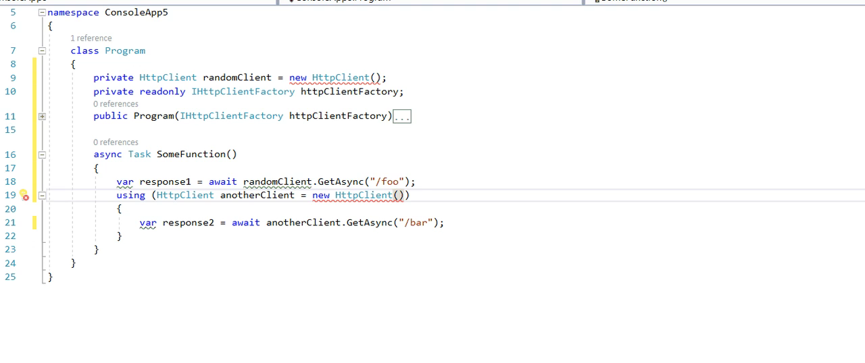

Slide 36

Hosted Services

Slide 37
Hosted Service
public interface IHostedService
{
Task StartAsync(CancellationToken cancellationToken);
Task StopAsync(CancellationToken cancellationToken);
}
builder.Services.AddSingleton<IHostedService, AwesomeHostedService>();
// ...

Slide 38
public class AwesomeHostedService : IHostedService
{
private readonly ITwitterApi twitterApi;
private readonly IMemoryCache cache;
public AwesomeHostedService(ITwitterApi twitterApi, IMemoryCache cache)
{
this.twitterApi = twitterApi;
this.cache = cache;
}
public Task StartAsync(CancellationToken cancellationToken) =>
PullTweets();
public Task StopAsync(CancellationToken cancellationToken) =>
Task.FromResult(0);
// ...

Slide 39
// ...
private async Task PullTweets()
{
while (true)
{
var sinceId = cache.Get<long>("sinceId");
var tweets = await twitterApi.Search("#DutchDotNet", sinceId);
var tweetStrings = new StringBuilder();
foreach (var tweet in tweets)
tweetStrings.AppendLine($"{tweet.Date} {tweet.Text} {tweet.User}");
await File.AppendAllTextAsync("tweets.csv", tweetStrings.ToString());
await Task.Delay(10000);
}
}
}

Slide 40

The RESTy stuff

Slide 41
ApiController attribute
Automagically responds with 400 for validation errors
Smarter bindings
[FromBody] → Complex types
[FromRoute] → Route values
[FromQuery] → Query params
[FromServices] → Service resolver
Requires Attribute Routing
Not needed: Auto inferred in .NET 7

Slide 42
ActionResult<T>

Slide 43
public class Numbers
{
[Required] public int? Number1 { get; set; }
[Required, Range(1,100)] public int? Number2 { get; set; }
}
[Route("api/[controller]")]
[ApiController]
public class CalculatorController : ControllerBase
{
public ActionResult<int> Post([Required]Numbers numbers, string key)
{
if (key != "SecretKey") return Unauthorized();
return (numbers.Number1 * numbers.Number2);
}
}

Slide 44
RFC 7807

Slide 45
{
"errors": {
"Number1": [
"The Number1 field is required.“
],
"Number2": [
"The field Number2 must be between 1 and 100.“
]
},
"type": "https://api.awesome.io",
"title": "One or more validation errors occurred.",
"status": 400,
"detail": "Go read the docs, duh!",
"instance": "/api/calculator"
}

Slide 46
Problem Details
builder.Services.AddProblemDetails();
// ...

Slide 47
builder.Services.AddProblemDetails(options =>
options.CustomizeProblemDetails = (context) =>
{
var mathErrorFeature = context.HttpContext.Features.Get<MathErrorFeature>();
if (mathErrorFeature is not null)
{
(string Detail, string Type) details = mathErrorFeature.MathError switch
{
MathErrorType.DivisionByZeroError =>
("Divison by zero is not defined.",
"https://wikipedia.org/wiki/Division_by_zero"),
_ =>
("Negative or complex numbers are not valid input.", "https://wikipedia.org/wiki/Square_root")
};
context.ProblemDetails.Type = details.Type;
context.ProblemDetails.Title = "Bad Input";
context.ProblemDetails.Detail = details.Detail;
}
});

Slide 48

Model Binding

Slide 49
Model binder definition
public interface IModelBinder
{
Task BindModelAsync(ModelBindingContext bindingContext);
}

Slide 50





AwesomeModelBinder
[
{ x, y, width, height },
{ x, y, width, height },
{ x, y, width, height },
{ x, y, width, height }
]
Awesome
ModelBinder
Photo
Azure Face API

Slide 51
Demo: Face Detection Binder

Slide 52

Conventions

Slide 53
// GET api/people/names
namespace Api.People;
[Route("api/people/names")]
public class NamesController
{
public string[] Get([FromServices]IPeopleRepository people)
{
return people.All;
}
}

Slide 54
Convention definitions
public interface IApplicationModelConvention
{
void Apply(ApplicationModel application);
}
public interface IControllerModelConvention
{
void Apply(ControllerModel controller);
}
public interface IActionModelConvention
{
void Apply(ActionModel action);
}

Slide 55
Application model
Controllers
API explorer
Filters
Actions
API explorer
Filters
Application
API Explorer
Filters
Parameters

Slide 56
// GET api/people/names
namespace Api.People;
public class NamesApi
{
public string[] Get(IPeopleRepository people) =>
return people.All;
}

Slide 57
Demo: Custom Convention

Slide 58

Application Parts

Slide 59
Load external MVC during runtime
var assembly = Assembly.LoadFile(@"c:\random\awesome.dll");
builder.Services
.AddMvc()
.AddApplicationPart(assembly);
// ...

Slide 60
Demo: Application Parts

Slide 61
HATEOAS

Slide 62


Slide 63
Hypermedia as the Engine of Application State

Slide 64


Slide 65
HATEOAS
Client
What can you do?
Server
OPTIONS /

Slide 66
HATEOAS
Client
application/json+hateoas
Server
[
{ "_self" : "OPTIONS /" }
{ "list-foo" : "GET /api/foo" },
{ "list-bar" : "GET /api/bar" },
{ "list-baz" : "GET /api/baz" }
]

Slide 67
HATEOAS
Client
list-bar
Server
GET /api/bar

Slide 68
HATEOAS
Client
application/json+hateoas
Server
[
{ "_self" : "GET /api/bar" }
{ "create-bar" : "POST /api/bar" },
{ "data" : { ... } }
]

Slide 69
HATEOAS
Client
create-bar
Server
POST /api/bar
{ ... }

Slide 70
HATEOAS
Client
application/json+hateoas
Server
[
{ "_self" : "GET /api/bar/1" },
{ "remove-bar" : "DELETE /api/bar/1" },
{ "update-bar" : "PUT /api/bar/1" },
{ "list-bar" : "GET /api/bar" },
{ "data" : { ... } }
]

Slide 71
HATEOAS
Client
remove-bar
Server
DELETE /api/bar/1

Slide 72
HATEOAS
Client
application/json+hateoas
Server
[
{ "_self" : "OPTIONS /api/bar" },
{ "create-bar" : "POST /api/bar" },
{ "list-bar" : "GET /api/bar" }
]

Slide 73
Demo: HATEOAS

Slide 74
Channels

Slide 75
IStartupFilter
Config per environment
IServer
HttpClientFactory
IHostedService
[ApiController]
ActionResult<T>
IModelBinder
Conventions
ApplicationPart
HATEOAS, Channels…
RFC 7807

Slide 76

https://rynd.rs/aspnet-hidden-gems

Slide 77
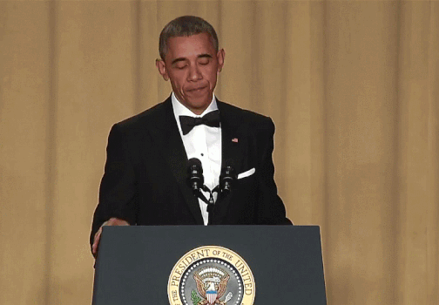

Thank you!
Fanie Reynders
Freelance Cloud Architect
https://reynders.co
@FanieReynders

